Slide 1


Risk & Reward
Nathan Dwyer &
Zeke Herrera

Slide 2

Overview
Analyze 12 stocks
Two stock categories (Pharmaceutical/Tech)
6 High volatile , 6 low volatile
Create two portfolios short term and long term to recommended to clients
Hypothesis
High volatile stock will perform great short-term
Low volatile stocks will perform better long term

Slide 3
Stocks & Volatility
Tech Stocks
High Volatility | Low Volatility
NVDA | VZ
EBIX | NTES
AOSL | DELL
Pharmaceutical Stocks
High Volatility | Low Volatility
ARCT | MRK
INMD | BMY
SCYX | PFE

Slide 4
Motivation
What stocks will perform better?
Does volatility have an impact on the stock?
Will all the stocks perform well enough to utilize them in a portfolio?

Slide 5
Data Collection
Collection
Researched stocks in both categories utilizing both the NASDAQ and Yahoo Finance
For high volatility we wanted stocks over a 2.0 beta, and below a 1.0 beta for low volatile stocks
Stocks with at least 5 years of data
Issues
Some stocks did not have 5 years of data

Slide 6

Achieving Project Goals (Steps)
Read in libraries/ imports
Use one stock to create the steps for an MC Simulation (NVDA)
Create a function (Risk Simulation), taking steps from our NVDA simulation to allow us to streamline the process with our other stocks
Use function to run our MC Simulations on the rest of our chosen stocks for short term and long-term portfolios
Short Term (1,3,5) Long Term (8,10,15)
5. Collect data from MC Simulations (lower and upper 95%)
6. Use data to separate stocks into best suited portfolio

Slide 7
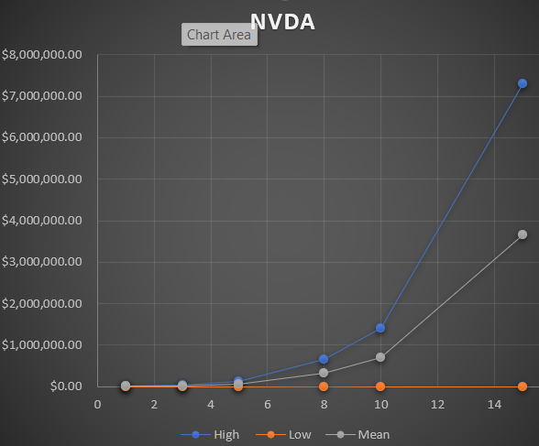
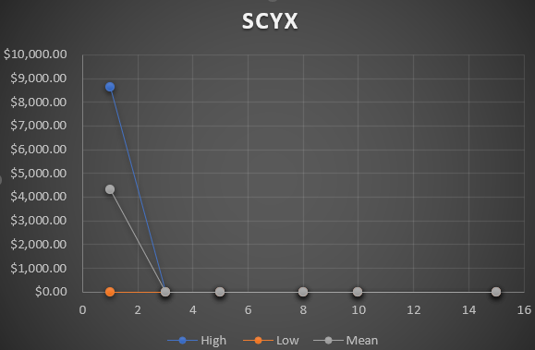
Results
Short Term Portfolio:
EBIX, VZ, ARCT, INMD, PFE
Long Term Portfolio:
NVDA, AOSL, NTES, DELL, MRK
Not Included:
SCYX

Slide 8
Conclusions/Analysis
Conclusions
Contrary to our initial hypothesis, the volatility of stocks does not outwardly affect the long-term or short-term potential of a given stock when run through a MC Simulation
Financial Application/ Analysis
Although some stocks in these portfolios indicate there is a lot of money to be made by taking the advice of MC Simulations to invest, an MC Simulation should be mainly used as a forecasting tool. It does not take into account many factors including financial crisis, bear markets, or recessions. They should mainly be used to estimate the probability of a certain outcome

Slide 9
What could we have done differently?
If we had more time:
Finished function to run multiple MC Simulations and stocks at once
Simulate the stocks once placed in their portfolios to see if performance was affected
Take skewed data out to normalize findings
Plan for next time(Future development):
Read in files using csv or Morningstar to see if it helps with MC Simulation function( we were not able to find a way to run multiple stocks at once with yfinance)
Run a simulation using 5 years of data from ten years ago. To see how accurate the MC Simulation would be

